Slide 1

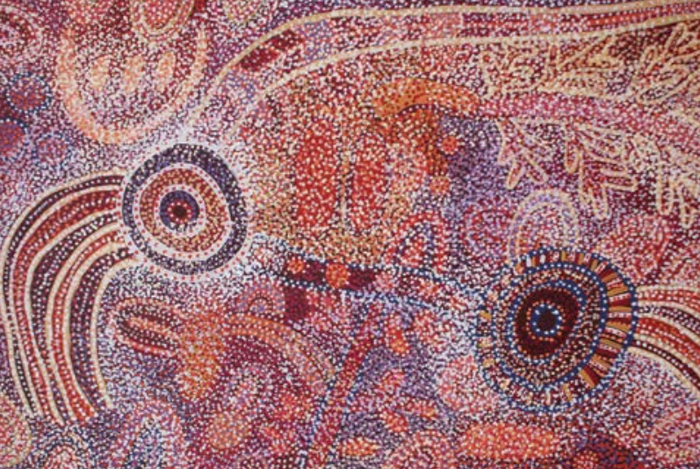
Acknowledgement of Country
We respectfully acknowledge the Kaurna, Boandik and Barngarla First Nations Peoples and their Elders past and present, who are the First Nations’ Traditional Owners of the lands that are now home to the University of South Australia’s campuses in Adelaide, Mount Gambier and Whyalla. We are honoured to recognise our connection to the Kaurna, the Boandik and the Barngarla lands, and their history, culture and spirituality through these locations, and we strive to ensure that we operate in a manner which respects their Elders and ancestors. We also acknowledge the other First Nations of lands across Australia with which we conduct business, their Elders, ancestors, cultures and heritage.
Image courtesy of the artist and Mimili Maku Arts, University of South Australia Art Collection by the artist, Ngupulya PUMANI, b. 1948 Mimili, South Australia. Pitjantjatjara.

